Slide 1
Image Representation
Course Code: CSC 3224
Course Title: Computer Graphics
Dept. of Computer Science
Faculty of Science and Technology
Lecturer No: | 03 | Week No: | 2 | Semester:
Lecturer:

Slide 2
Outline
Pixel
Graphics Image (Raster and Vector)
How the images are formed
Color Model (RGB, CMY)
Coloring Techniques
5.1. Direct Coding
5.2. Lookup Table
6. Printing
6.1. Halftone
6.2. Halftone Approximation
Image Files
Books
References

Slide 3
Pixel
A pixel is one of the many tiny dots that make up the representation of a picture in a computer's memory.
Pixels in an image can be reproduced at any size without the appearance of visible dots or squares
The intensity of each pixel is variable; in color systems, each pixel has typically three or four dimensions of variability such as red, green and blue, or cyan, magenta, yellow and black

Slide 4
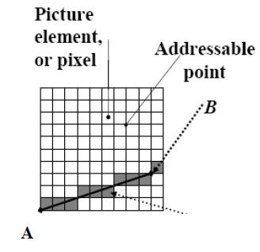
Pixel

Slide 5
Computer Graphics Image
Computer graphics can be created as either raster or vector images
Raster Image
Vector Image

Slide 6
Raster Image
Raster graphics are bitmaps.
A bitmap is a grid of individual pixels that collectively compose an image.
Raster graphics render images as a collection of countless tiny squares.
Each square, or pixel, is coded in a specific shade. Individually, these pixels are worthless
Together, they’re worth a thousand words

Slide 7
Raster Image
Using of Raster Image
Raster graphics are best used for non-line art images; specifically digitized photographs, scanned artwork or detailed graphics
Non-line art images are best represented in raster form because these typically include subtle chromatic gradations, undefined lines and shapes, and complex composition

Slide 8
Drawbacks of Raster Image
Resolution in raster graphics is measured in dpi, or dots per inch. The higher the dpi, the better the resolution
Raster files are significantly larger than comparable vector files, high resolution raster files are significantly larger than low resolution raster file
Overall, as compared to vector graphics, raster graphics are less economical, slower to display and print, less versatile and more unwieldy to work with

Slide 9
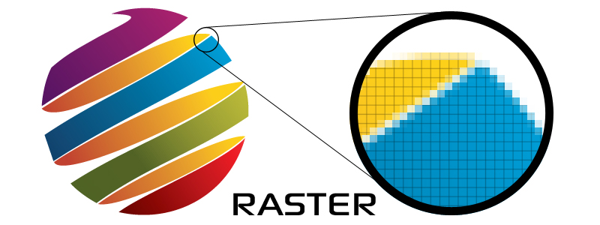
Example of Raster Image
Common raster formats include TIFF, JPEG, GIF, PCX and BMP files

Slide 10
Vector Image
Unlike pixel-based raster images, vector graphics are based on mathematical formulas that define geometric primitives such as polygons, lines, curves, circles and rectangles

Slide 11
Use of Vector Image
Because vector graphics are composed of true geometric primitives, they are best used to represent more structured images, like line art graphics with flat, uniform colors.
Most created images meet these specifications, including logos, letterhead, and fonts.

Slide 12
Advantages of Vector Image
vector-based graphics are more malleable than raster images
they are much more versatile, flexible and easy to use
The most obvious advantage of vector images over raster graphics is that vector images are quickly and perfectly scalable
There is no upper or lower limit for sizing vector images

Slide 13
Advantages of Vector Image
unlike raster graphics, vector images are not resolution-dependent
Vector images have no fixed intrinsic resolution, rather they display at the resolution capability of whatever output device (monitor, printer) is rendering them
because vector graphics need not memorize the contents of millions of tiny pixels, these files tend to be considerably smaller than their raster counterparts.

Slide 14

Vector Images
Overall, vector graphics are more efficient and versatile.
Common vector formats include AI, EPS, CGM, WMF and PICT (Mac).

Slide 15
Color Model
A color model is a system for creating a full range of colors from a small set of primary colors.
There are two types of colour models: additive and subtractive.

Slide 16
Additive and Subtractive Model
Additive color models use light to display color
while subtractive color models use printing inks.
Colors perceived in additive models are the result of transmitted light.
Colors perceived in subtractive models are the result of reflected light.

Slide 17
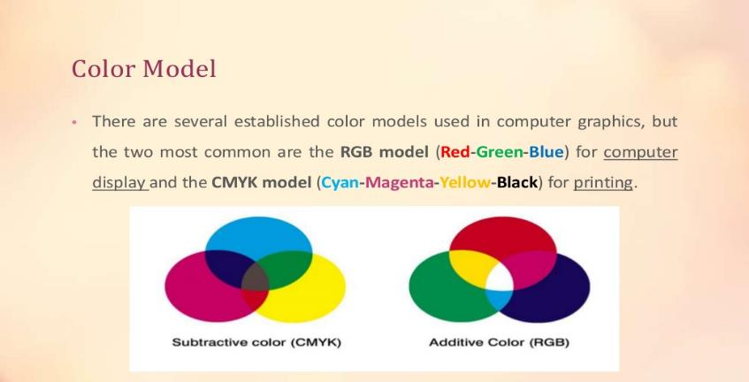
RGB and CMYK

Slide 18
RGB
RGB uses additive color mixing, because it describes what kind of light needs to be emitted to produce a given color.
Light is added together to create form from out of the darkness.
RGB stores individual values for red, green and blue.
(r,g,b)=>(0,0,0) black, (1,1,1) white [ranges 0 to 1]

Slide 19
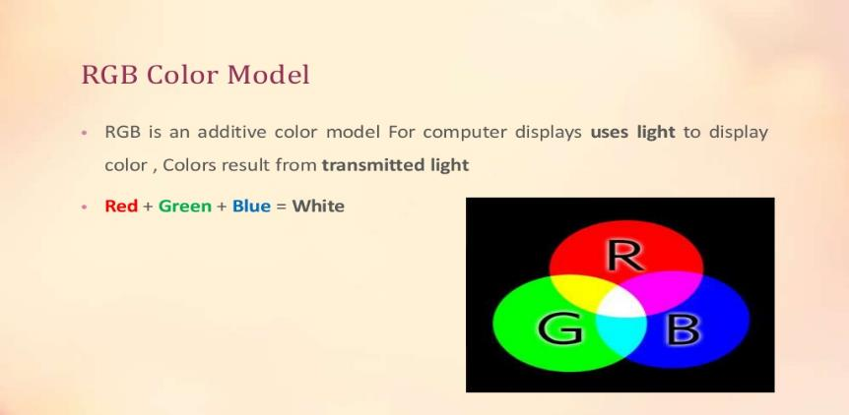
RGB

Slide 20
RGB Value
A color's RGB value indicates its red, green, and blue intensity.
Each intensity value is on a scale of 0 to 255

Slide 21
RGB Color Palette
3-bit RGB
Systems with a 3-bit RGB palette use 1 bit for each of the red, green and blue color components. That is, each component is either "on" or "off" with no intermediate states. This results in an 8-color ((2¹)³ = 2³ = 8) palette
6-bit RGB
Systems with a 6-bit RGB palette use 2 bits for each of the red, green, and blue color components. This results in a (2²)³ = 4³ = 64-color palette

Slide 22
Color Palette
In computer graphics, a color palette is a finite set of colors. Palettes can be optimized to improve image accuracy in the presence of software or hardware constraints.

Slide 23
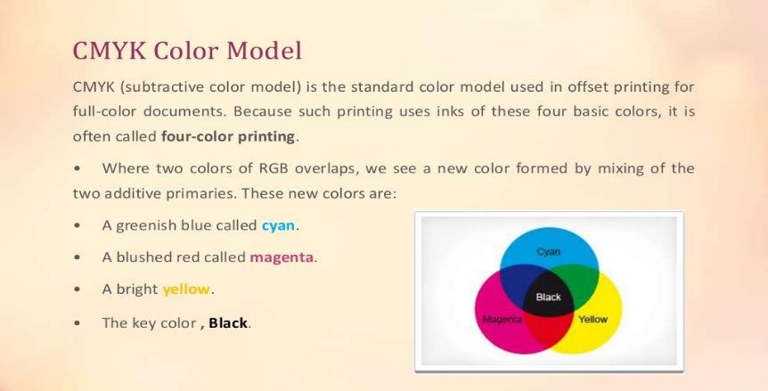
CMYK

Slide 24
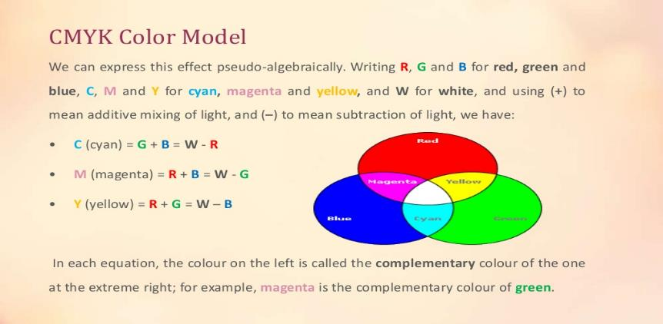
CMYK

Slide 25
CMY
CMY uses subtractive color mixing used in the printing process, because it describes what kind of inks need to be applied so the light reflected from the substrate and through the inks produces a given color.
One starts with a white substrate (canvas, page, etc.), and uses ink to subtract color from white to create an image.
CMYk stores ink values for cyan, magenta, yellow, Key(Black).
cmyk(c%, m%, y%)=>(0%,0%,0%) white. [ranges from 0 to 100%]

Slide 26
RGB to CMY
C = 1 –( color.R / 255.0);
M = 1 – (color.G / 255.0);
Y = 1 – (color.B / 255.0);

Slide 27
RGB to CMY
R = (1 - C) * 255.0,
G = (1 - M) * 255.0,
B = (1 - Y) * 255.0

Slide 28
RGB -> CMY -> RGB
More info
http://colormine.org/convert/rgb-to-cmy
Sample Code:
https://github.com/THEjoezack/ColorMine/blob/master/ColorMine/ColorSpaces/Conversions/CmyConverter.cs

Slide 29
Direct Coding
Basically images are the collections of several pixels with colors. In computer graphics, direct coding is an algorithm that provides some amount of storage space for each pixel so that the pixel is coded with a color.

Slide 30
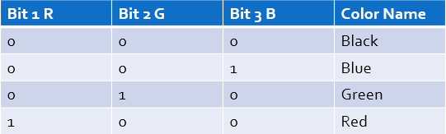
Direct Coding
Storage space for each pixel to code the color
Use 3 bytes per pixel (1 for R, 1 for G and 1 for B) [Industry standard]
256 different intensity level for each color

Slide 31
Direct Coding
More info of direct coding:
https://www.chegg.com/homework-help/definitions/direct-coding-3

Slide 32
Lookup Table
In computer graphics, lookup tables are used to store the starting addresses of each line and the values corresponding to the placement of pixels within a byte.

Slide 33
Steps to plot a point using lookup table
1. Locate the starting address corresponding to the line on which the point is to appear.
2. Locate the address of the byte in which the point will be represented.

Slide 34
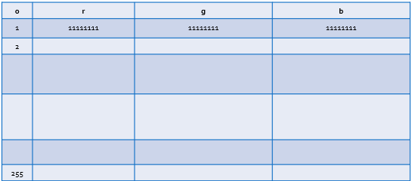
Lookup Table
Pixel values do not code colors directly
Refer to a table of color values
A table with 256 colors with RGB values

Slide 35
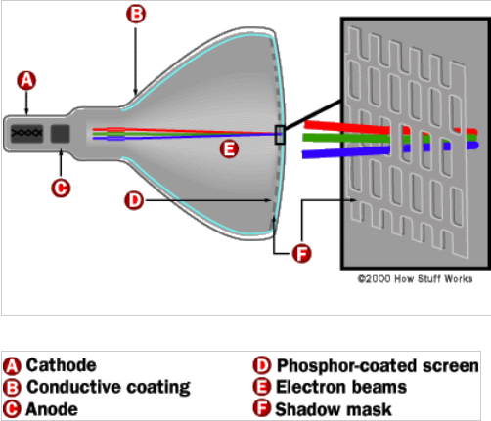
Display Monitor (CRT)

Slide 36
Printing
Halftone
Go through chapter 2 (schaum’s outline) for details.

Slide 37
Halftone
Halftone is the technique that simulates continuous tone imagery through the use of dots.
Dots can be varied either
in size
in shape or
in spacing
Halftone generates a gradient like effect.

Slide 38
Halftone Image
A halftone, or halftone image, is an image comprised of discrete dots rather than continuous tones. When viewed from a distance, the dots blur together, creating the illusion of continuous lines and shapes.
By halftoning an image (converting it from a bitmap to
a halftone), it can be printed using less resources

Slide 39
How Halftone work
Halftone process, in printing, a technique of breaking up an image into a series of dots so as to reproduce the full tone range of a photograph or tone art work.

Slide 40
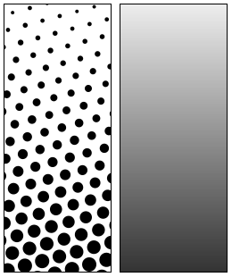
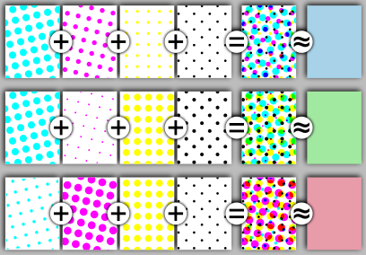
Example

Slide 41
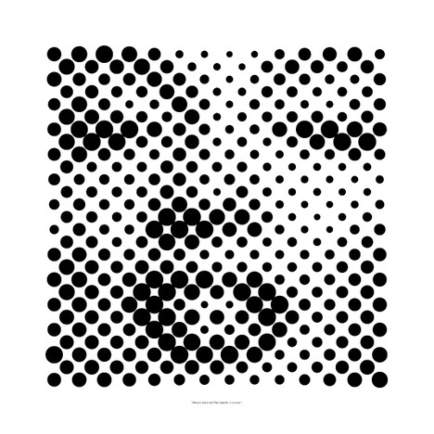
Contd.

Slide 42
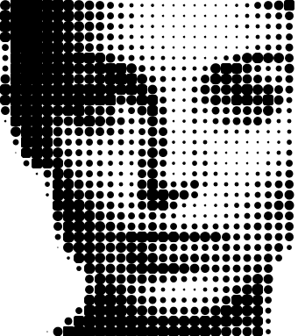
Contd.

Slide 43
Dithering
A technique called dithering can be used to approximate halftones without reducing spatial resolution.
The dither matrix is treated very much like a floor tile that can be repeatedly positioned one copy next to another to cover the entire floor, i.e., the image.
A pixel at (x,y) is intensified if the intensity level of the image at that position is greater than the corresponding value in the dither matrix. Mathematically, if Dn stands for an n x n dither matrix, the element Dn(i,j) that corresponds to pixel position (x,y) can be found by i = x mod n and y = y mod n.
for image areas that have constant intensity, the results of dithering are exactly the same as the results of halftone approximation. Reproduction differences between these two methods occur only when intensity varies.

Slide 44
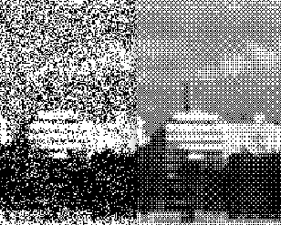
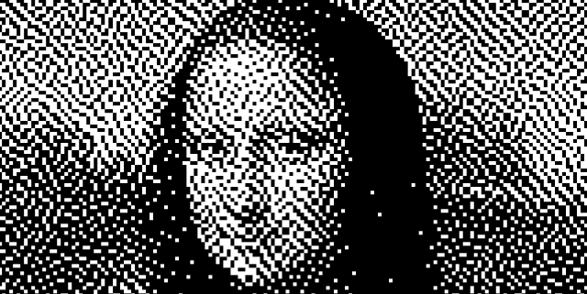
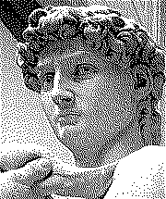
Dithering

Slide 45
Error Diffusion
Another technique for continuous-tone reproduction without sacrificing spatial resolution is called the Floyd-Steinberg error diffusion.
Here a pixel is printed using the closest intensity the device can deliver. The error term, i.e., the difference between the exact pixel value and the approximated value in the reproduction, is then propagated to several yet-to-be-processed neighboring pixels for compensation.

Slide 46
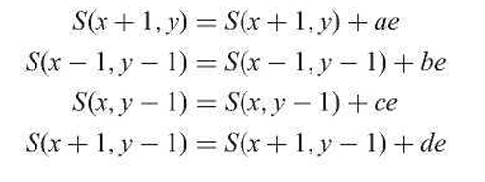
Error Diffusion
let S be the source image that is processed in a left-to-right and top-to-bottom pixel order, S(x,y) be the pixel value at location {x,y), and e be S(x,y) minus the approximated value. We update the value of the pixel's four neighbors (one to its right and three in the next scan line) as follows:

Slide 47
Error Diffusion
Where parameters a through d often take values 7/16, 3/16, 5/16, and 1/16 respectively. These modifications are for the purpose of using the neighboring pixels to offset the reproduction error at the current pixel location. They are not permanent changes made to the original image.
Consider, for example, the reproduction of a gray scale image (0: black, 255: white) on a bilevel device (level 0: black, level 1: white), if a pixel whose current value is 96 has just been mapped to level 0, we have e = 96 for this pixel location. The value of the pixel to its right is now increased by 96 x (7/16) = 42 in order to determine the appropriate reproduction level.
This increment tends to cause such neighboring pixel to be reproduced at a higher intensity level, partially compensating the discrepancy brought on by mapping value 96 to level 0 (which is lower than the actual pixel value) at the current location. The other three neighboring pixels (one below and to the left, one immediately below, and one below and to the right) receive 18, 30, and 6 as their share of the reproduction error at the current location, respectively. Results produced by this error diffusion algorithm are generally satisfactory, with occasional introduction of slight echoing of certain image parts. Improved performance can sometimes be obtained by alternating scanning direction between left-to-right and right-to-left (minor modifications need to be made to the above formulas)

Slide 48
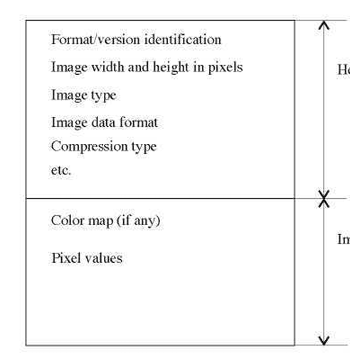
Image Files
A digital image is often encoded in the form of a binary file for the purpose of storage and transmission. Among the numerous encoding formats are BMP (Windows Bitmap), JPEG (Joint Photographic Experts Group File Interchange Format), and TIFF (Tagged Image File Format). Although these formats differ in technical details, they share structural similarities.
The file consists largely of two parts: header and image data. In the beginning of the file header a binary code or ASCII string identifies the format being used, possibly along with the version number. The width and height of the image are given in numbers of pixels. Common image types include black and white (1 bit per pixel), 8-bit gray scale (256 levels along the gray axis), 8-bit color (lookup table), and 24-bit color. Image data format specifies the order in which pixel values are stored in the image data section.

Slide 49
Books
Foley, van Dam, Feiner, Hughes, Computer Graphics: principles and practice, Addison Wesley, Second Edition.
Schaum's Outline of Theory & Problems of Computer Graphics.
Peter Shirley Steve Marschner , “Fundamental of computer graphics”, Third Edition.

Slide 50
References
http://colormine.org/convert/rgb-to-cmy
www.howstuffworks.com
www.wikipedia.com
http://www.picturetopeople.org/image_effects/photo-halftone/examples/photo-to-halftone-convertion-2.gif
http://mocoloco.com/fresh2/upload/2011/12/halftone_calendar_by_casey_klebba/halftone_calendar_casey_klebba_3b-thumb-468x468-35319.jpg
https://www.chegg.com
https://www.slideshare.net/mustafasalam167/color-model-29181025
https://www.printcnx.com/resources-and-support/addiational-resources/raster-images-vs-vector-graphics/
https://slideplayer.com/slide/5143930/

